Slide 1
Correcting AQS Data Externally

Slide 2
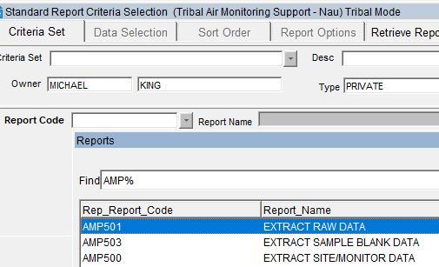
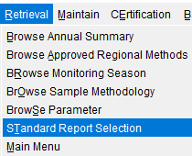
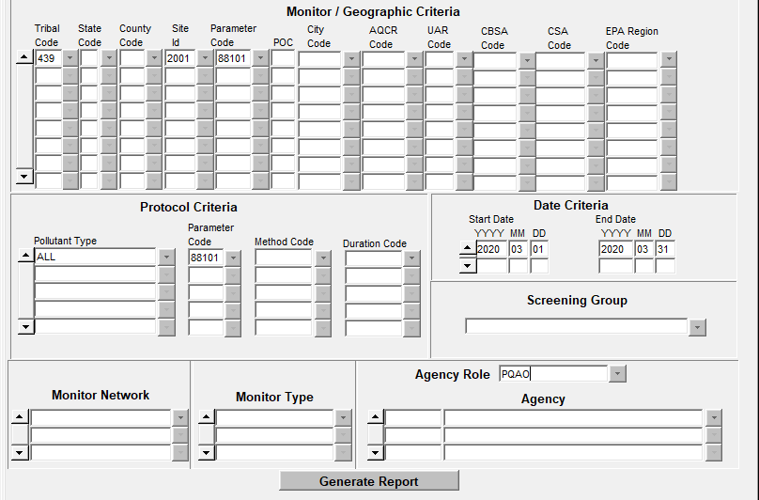
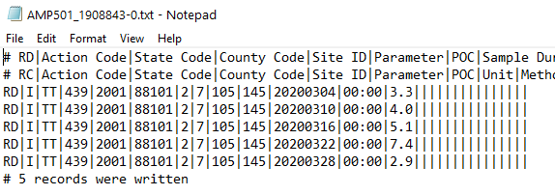
Run an AMP501 Extract Raw Data Report
Login to AQS
Go to “Retrieval” on menu
Select “Standard Report Selection” from dropdown list
Select “AMP501 Extract Raw Data” Report (Pipe-Delimited text file)
Replace with NULL CODE (BA)

Slide 3
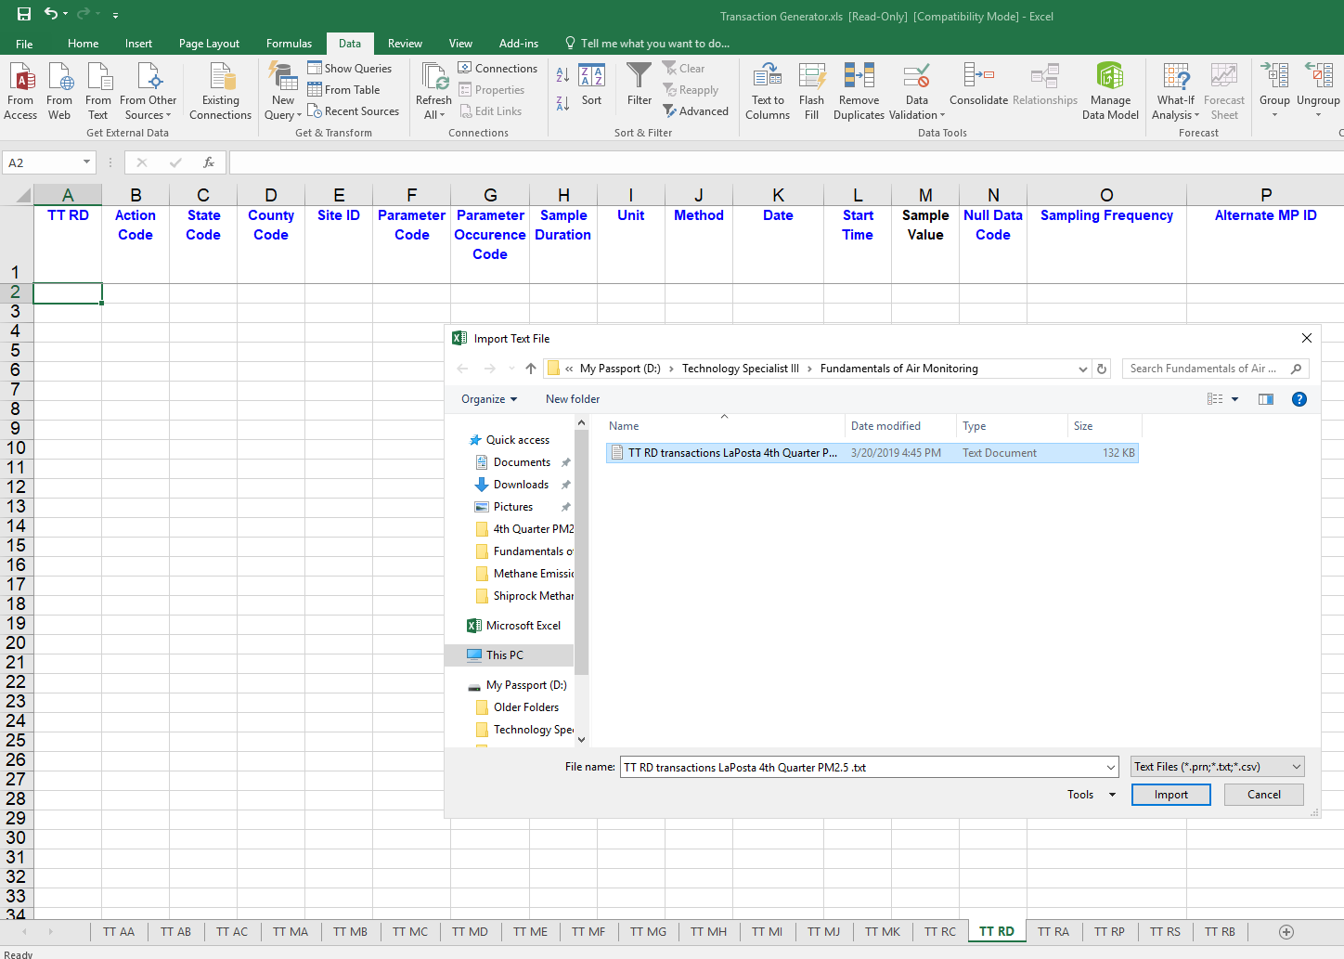
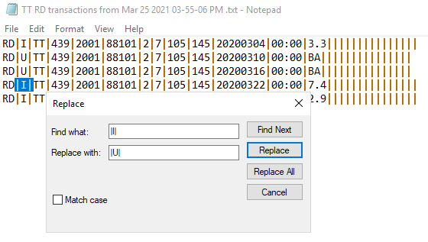
1.) Open Transaction Generator and select the TT RD (Raw Data) tab sheet
2.) Select Data and From Text.
3.) Navigate to your text file location and select Import to get Text File into Transaction Generator
Alternatively, you can use Notepad “Find & Replace” to update “U” the Action Indicator and CORRECT minor errors, then load text file back to AQS
Works okay with small data sets but large data sets can get tricky so we won’t talk too much about this

Slide 4
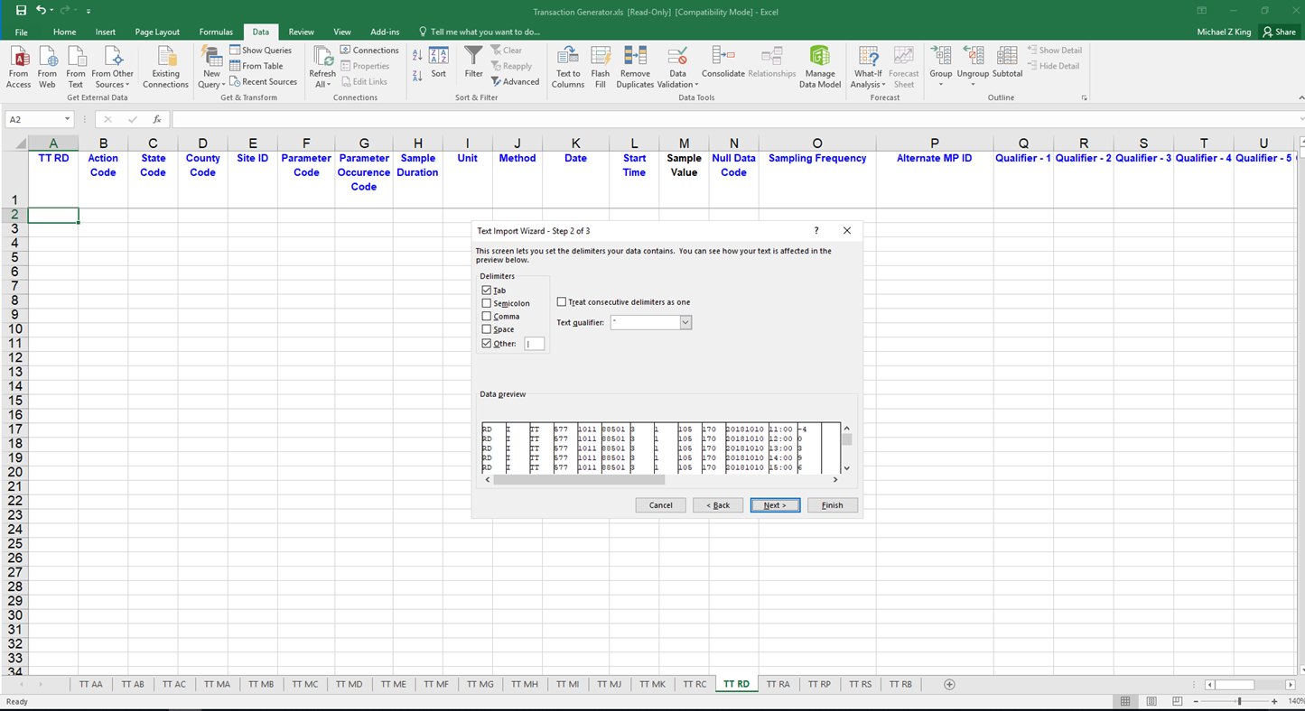
4.) Select delimiter and type pipe symbol (|) in the box for Other
Type Pipe Symbol (I) by holding down shift key and press the pipe or backslash key located above the enter key

Slide 5
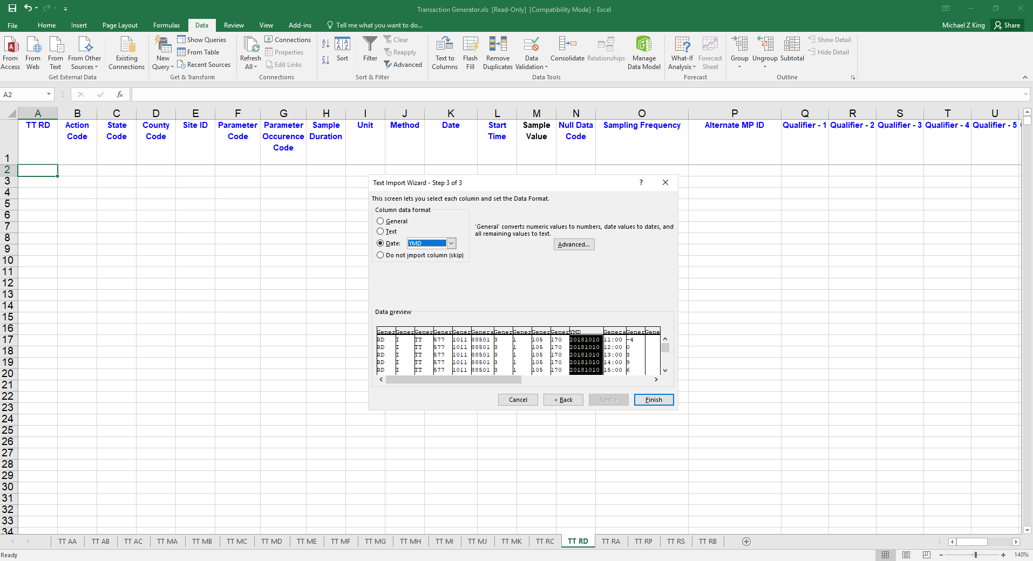
5.) Next, select YMD for the date column (e.g. 20181010), and select Text for the method, unit and hour columns.
6.) Select Finish.

Slide 6
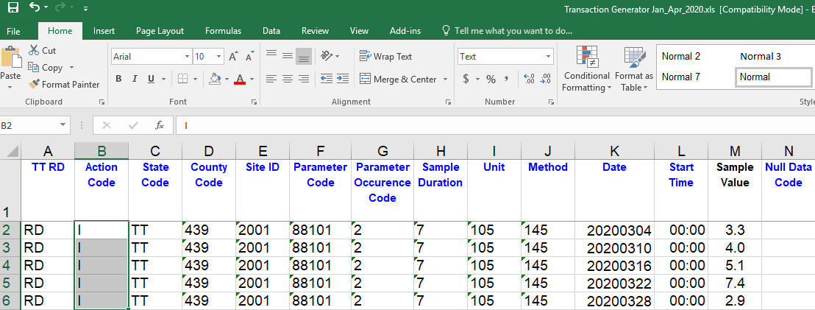
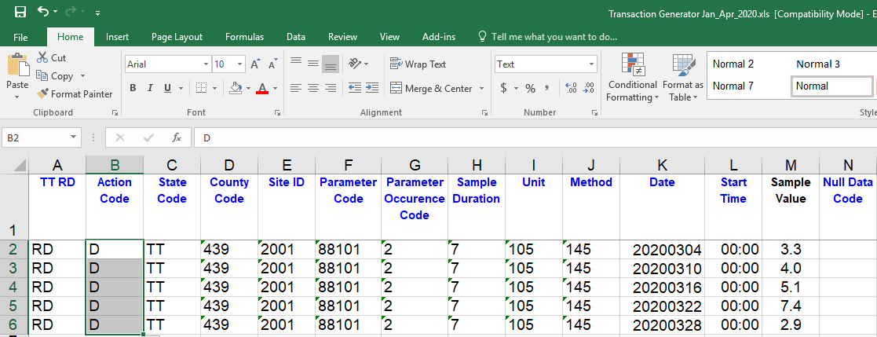
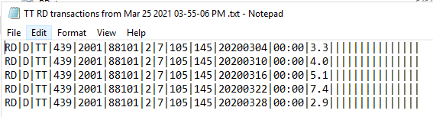
The text file should now be imported successfully into the Transaction Generator.
1.) Remove Action Indicator “I” for insert and replace with “D” for DELETE.
2.) Highlight rows and go to Add-ins then Generate an AQS Ready Pipe-Delimited text file with Action Indicator “D”
3.) Upload this file to AQS to remove existing data with ERRORS

Slide 7
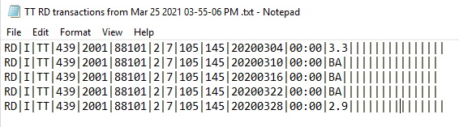
Use Transaction Generator to CORRECT data. After making corrections, update the Action Indicator to “I” for Insert. Highlight all rows with data, select “Add-Ins” in the menu tab and then “Generate Transactions.”
Upload the CORRECTED Pipe-Delimited text file to AQS

